Slide 1
The Use of In-Home Visits by Energy Efficiency Coaches to Help Low-Income People Reduce Electric Consumption
Capstone Community Action Weatherization
Barre, VT
Anita Kelman

Slide 2
What Do We Do?
Using one-on-one visits to connect with low-income households and achieve both thermal and electrical energy savings.

Slide 3
It all began when…….
Project started with a DOE SERC grant in 2011
To provide “efficiency coaching” based on CBSM
A curriculum was developed
based on the results of
client knowledge surveys

Slide 4
All five WAPS in Vermont participated in this project
By the end of the grant in June 2012, over 1,000 “contacts” with clients had been made

Slide 5
What We Did………
Areas initially covered included:
T-stat setbacks
Furnace/boiler care and operation
Moisture/humidity control
CO/Smoke detectors
General energy issues

Slide 6
In it’s reincarnation……
Efficiency coaching and coaches are required for all VT WAPS
The coaching visit is the first one of the WX process; precedes energy audit
Includes install of materials such as CO/Smokes, t-stats, H-gauges, etc.
Look for issues such as vermiculite, K&T, leaks
Electrical efficiency measures a big part now

Slide 7
What Do We Do?
CBSM still used but so are other approaches such as Motivational Interviewing
Visits can last for up to 4 hours
Some clients not WX but have high electric use and referred to us( > 10,000 kwh/yr)

Slide 8
Why Not Just Send Them Info or an Insert in a Bill?
Mostly because it just doesn’t work.

Slide 9
Using CBSM
Community Based Social Marketing strategies used:
Social Norms
Prompts
Communication
Incentives
Convenience

Slide 10
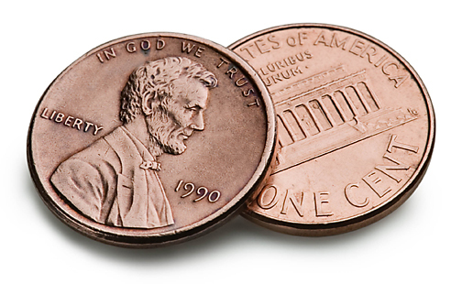
Who Are Low-Income People?
Their only commonality is having incomes below a set amount;
Can be young, old or in-between
Single or partnered
Families of all sizes
Illiterate or grad degrees
Gun-loving right-wing
Tree-hugging lefties

Slide 11
What Do They Want?
While some do want to save the planet(and the penguins and polar bears), ALL want to save money on their heating and electrical costs.
Saving money seems to be a unifying factor.

Slide 12
Electrical Efficiency and Conservation
Why is my electric company doing this to me?

Slide 13
High Users
Some clients are referred to us by
Efficiency Vermont due to their high
amount of electrical consumption,
generally over 10,000 kwh/year.

Slide 14
You use 400% more electricity than your neighbors!

Slide 15
Why Is Their Use So High?
While some clients have a good
idea, others are totally puzzled.

Slide 16
Horses Before Zebras…..

Slide 17
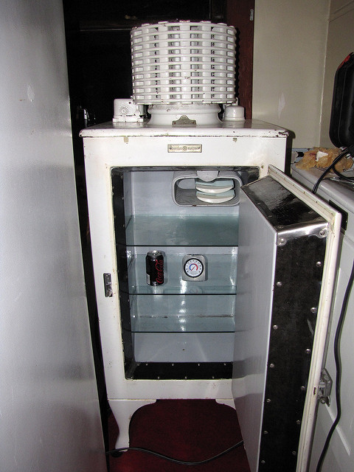
What Do We Find?
It varies. Can be:
Old appliances
Poor condition appliances
Electric heat
High demand on EWH
Houses full of incandescent bulbs
High AC use
And of course, behavior………..

Slide 18
What’s a kilowatt hour anyway?

Slide 19
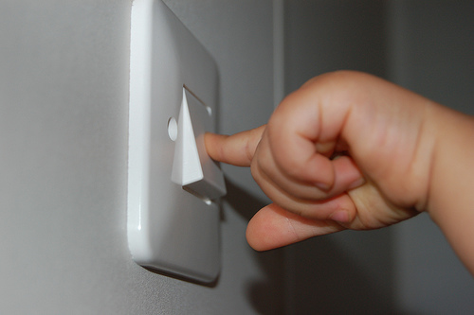
Hardware versus Software

Slide 20
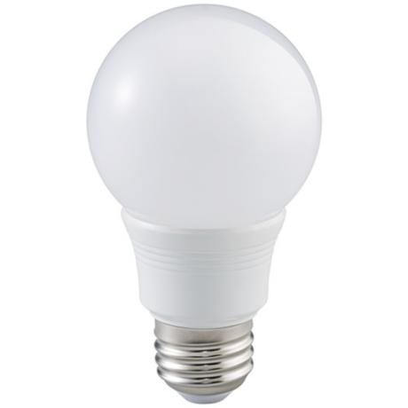
Hardware is Easy!
Replacing old inefficient appliances and light bulbs, eliminating electric resistance heating and other measures is the “easy stuff” for us to do.

Slide 21
Electrical Measures
With EVT funding we can
replace appliances, bulbs,
install HPWH, ASHP, do
custom measures, etc.
as needed.

Slide 22
The Hard Part
Changing Behaviors Around Energy Use

Slide 23
Turn It Off!

Slide 24
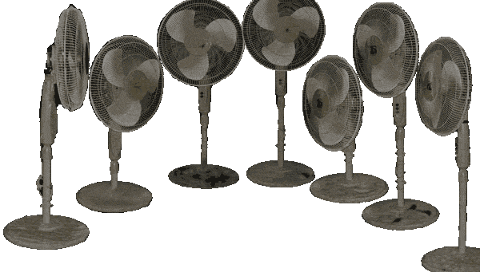
A Whole New Way to Think About Their Electric Use
If one fan is good, ten isn’t better……….

Slide 25
Get a Radio for Company and Turn Off the TV

Slide 26
Who uses hot water to wash clothes anymore??

Slide 27
Take Shorter Showers

Slide 28
And Those Lizard Tank Heaters

Slide 29
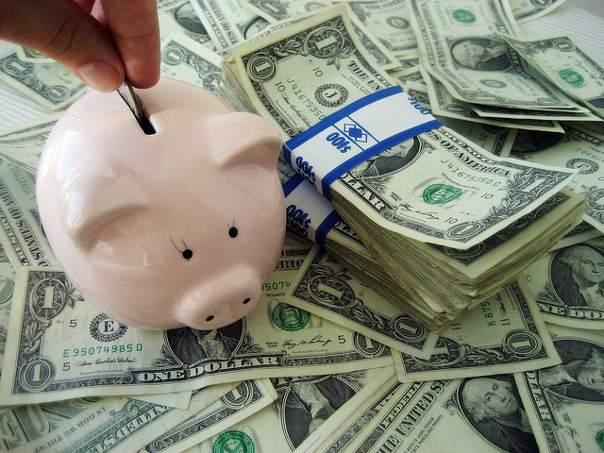
Success Breeds Success
Seeing the savings add up motivates clients to take additional steps.

