Slide 1
CAPI 2016 Fall Summit
Bridget Ashe
Manager, Customer Support
Efficiency Vermont

Slide 2
Agenda
Brief Intro
Overview of Offers and Services
-Residential
-Commercial
Solutions for High Use Customers

Slide 3
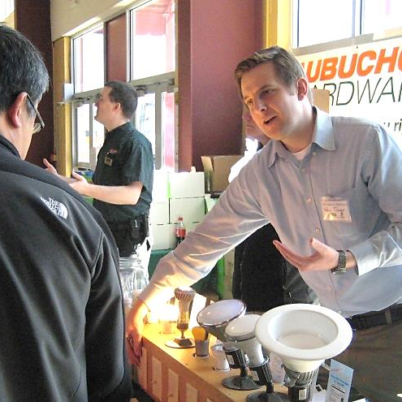
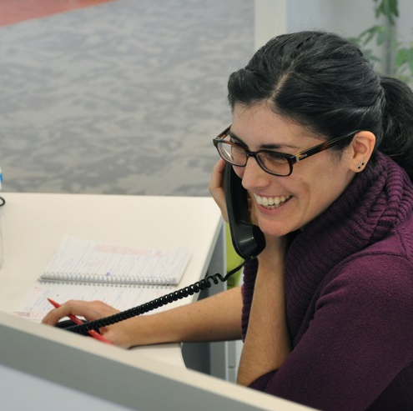
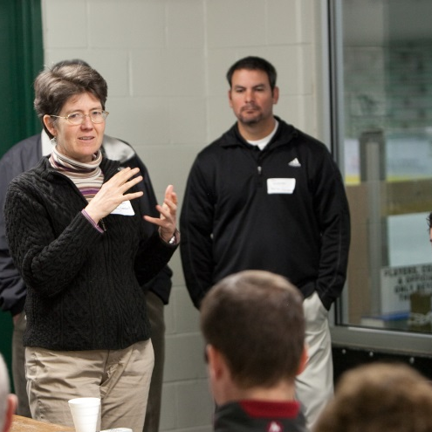
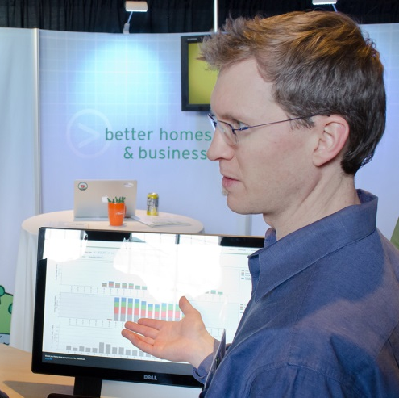
Who We Are
Founded in 2000
Statewide energy efficiency utility
Administered by VEIC, under appointment of Public Service Board

Slide 4
What We Do
Provide sustainable energy solutions
Education
Technical Assistance
Rebates & Incentives
Financing
Serve all Vermonters
Manage statewide contractor network

Slide 5
Residential Customers with High Usage
Getting Started…
It begins with a conversation.
*Phone Consultation*
888-921-5990

Slide 6
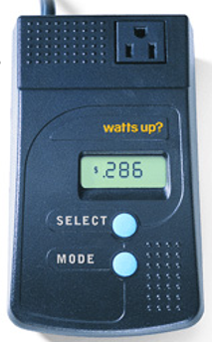
Recommendations, Offers and Services
Meter Loan
-Free Service
-Measures usage of electrical devices

Slide 7
Efficient Products
Appliances
Heating Systems
Water Heating Systems
Lighting
Electronic Devices
Ventilation
https://www.efficiencyvermont.com/rebates/list?cat=&type=Residential

Slide 8
Income Eligible Customers
Targeted High Use
WIC Refrigerator Replacement
Partner Referrals

Slide 9
Rental Properties
Notes:
Offers enhanced rebates on equipment and free lighting and water conservation devices like low flow shower heads and faucet aerators

Slide 10
Audits and Walk-Throughs
Home Energy Visits
Partner Referrals

Slide 11
Financing
Heat Saver Loan
Efficiency Vermont Loan Program
*In Progress*

Slide 12
Commercial Customers
Phone Consultation
Technical Assistance
Custom Rebate Offers
Standard Rebate Offers
Financing
1:1 Account Management Support
Referrals

Slide 13
THANK YOU!
Bridget Ashe
(802) 540-7652
bashe@veic.org

